Slide 1
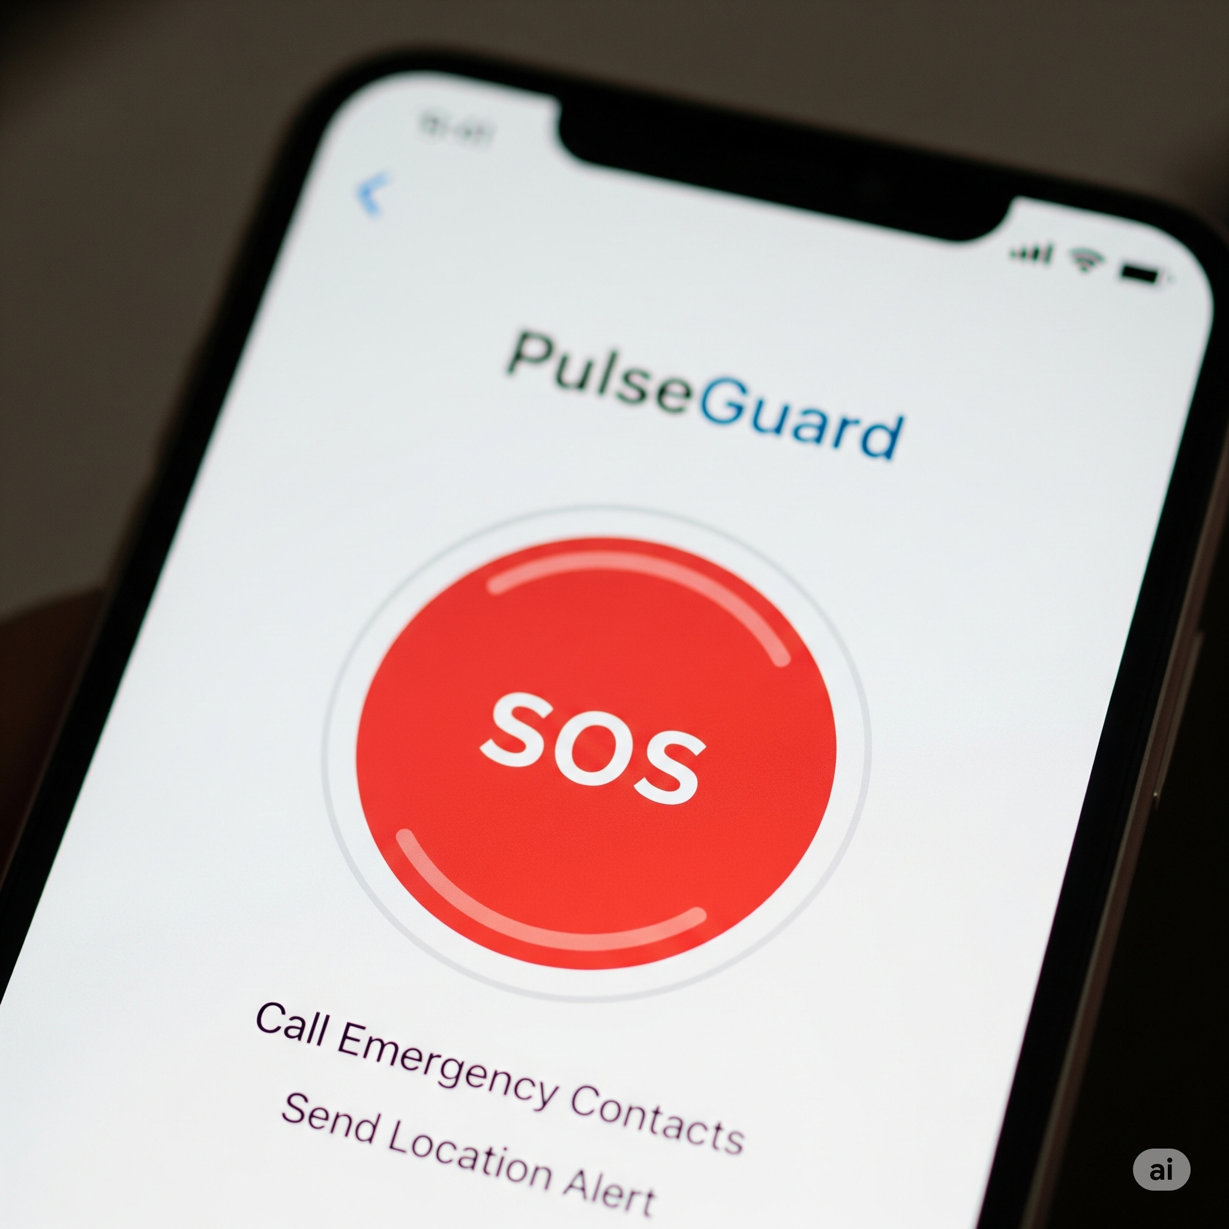
PLUSEGUARD
Batch No.D20
Pranay(23N31A05T4)
Vineeth(23N31A05N9)
Prem Raju(23N31A05L6)
Project Guide
Ms.R.Sujatha

Slide 2
Abstract
PulseGuard is a mobile application designed to deliver rapid emergency support through a single-tap SOS system. It instantly sends the user's live location to pre-saved emergency contacts, initiates a direct emergency call, and provides responders with vital medical information such as blood group, allergies, and pre-existing conditions.
It is built using Android, Firebase, and Google Maps API, PulseGuard ensures swift response and prioritizes user safety, particularly for students, elderly individuals, and those with medical vulnerabilities. The project aligns with SDG 3: Good Health and Well-being, promoting digital health preparedness, safety awareness, and responsible use of mobile technology for life-critical scenarios.

Slide 3
Thank You

